Slide 1

SAP PP (Production Planning) Product = Bicycle Manufacturing
- Neha Donekar
Programmer Analyst Trainee

Slide 2
Agenda
1 | Synopsis
2 | ERP
3 | SAP
4 | Product = BICYCLE
5 | Types of Project Planning
6 | Variety
7 | Master Data:
7.1 | Material Master
7.2 | Bill of Material
7.3 | Work Center
7.4 | Routing
7.5 | Production Version
8 | Transactional Data
8.1 | Demand Management
8.2 | Creating PIR
8.3 | Material Requirement Planning
8.4 | Production order
8.5 | Goods Issue
8.6 | Production Order Confirmation
8.7 | Goods Receipt
9 | REM
10 | SDLC

Slide 3
Synopsis
I have completed hands-on training in SAP Production Planning (SAP PP) using Bicycle manufacturing as a reference scenario, which falls under discrete manufacturing. In this project, I worked on the complete production cycle by creating and maintaining key master data such as material master (finished, semi-finished, and raw materials), bill of material (BOM), routing, work centers, and production versions. Based on planned demand, I executed transactional activities including demand management, MRP run, production order creation and release, goods issue, production order confirmation, and goods receipt of finished goods. This project gave me practical exposure to end-to-end production planning and execution in SAP PP, along with a clear understanding of the integration between planning, manufacturing, and inventory management.

Slide 4
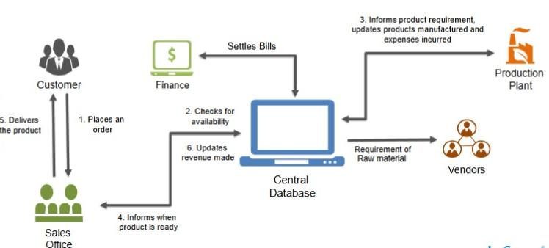
ERP (Enterprise Resource Planning)
"ERP comprises of a commercial software package that promises the seamless integration of all the information flowing through the company such as financial, accounting, human resources, supply chain and customers information."

Slide 5
SAP Overview
Founded in 1972
Headquartered in Waldorf, Germany
In German SAP means "System, Application & Products in Data Processing"
More Than 1,83,000 customers worldwide
More than 55,000 employees worldwide
World's Largest business software company
Revenue: Euro 34.18 billion(2024)

Slide 6
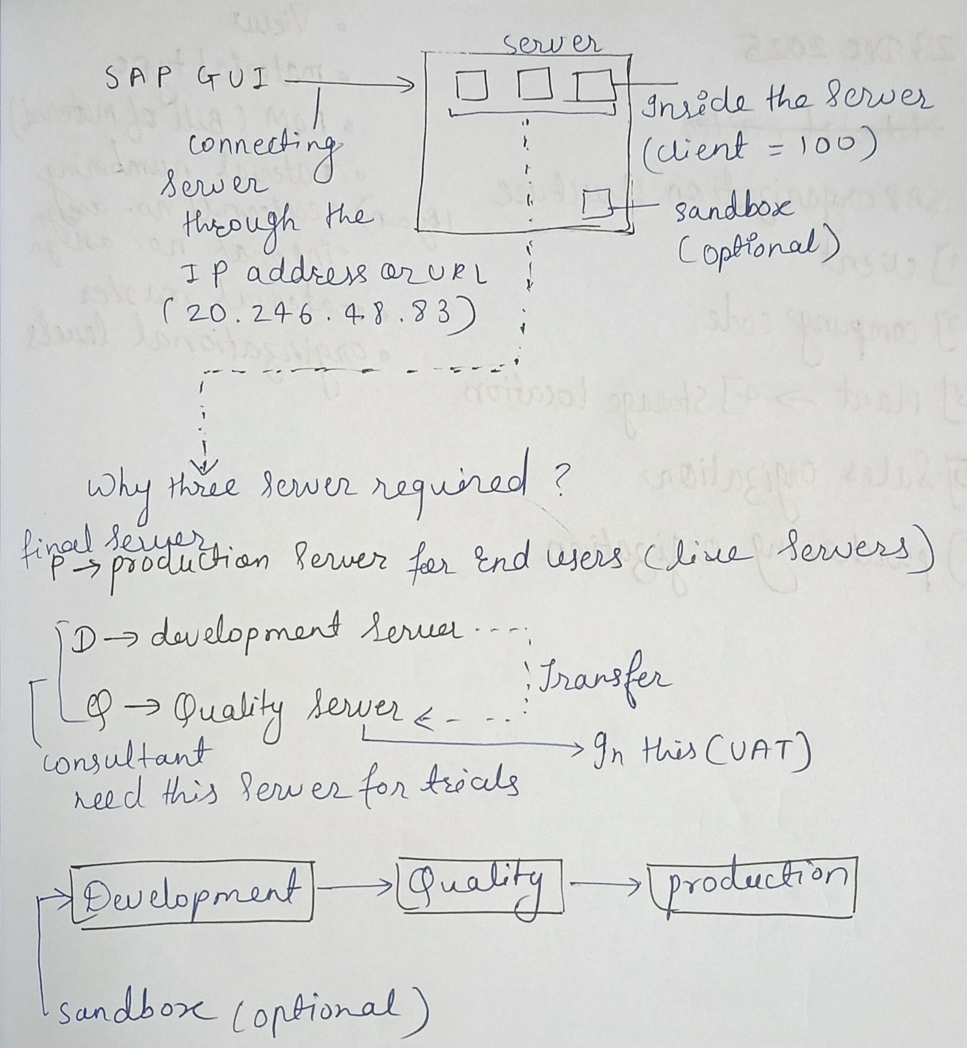
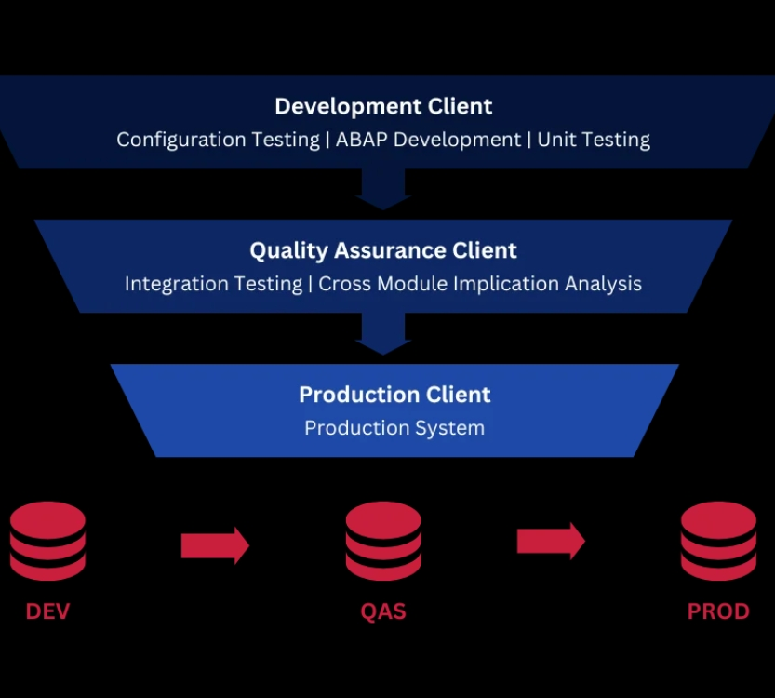
SAP Landscape Architecture

Slide 7
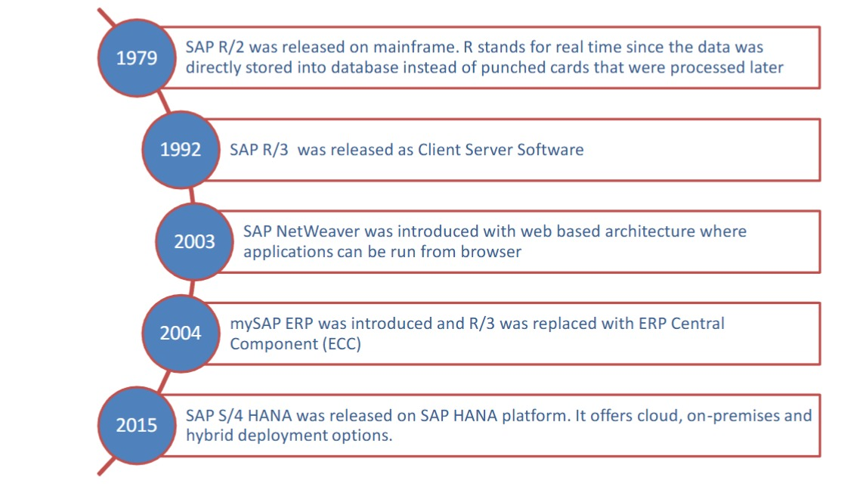
Evolution of SAP

Slide 8
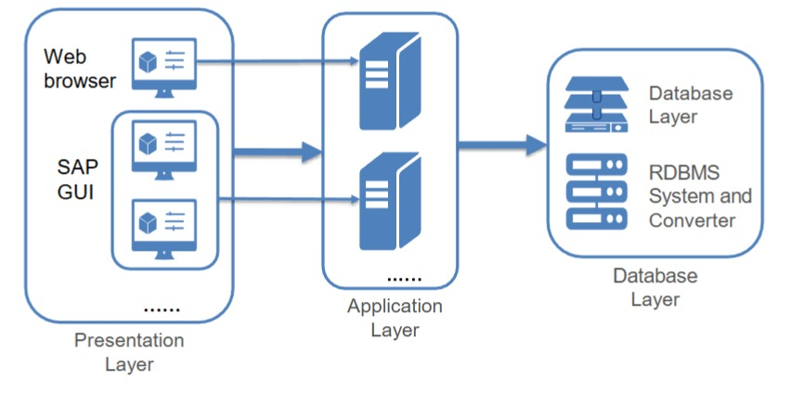
3 Tier Client / Server Architecture
The SAP R/3 architecture is based on a 3-tier Client/Server Model.
Presentation Layer
Application Layer
Database Layer
Dedicated Servers are Linked by Communication Networks.
Perform Tasks without sacrificing Data Integeration and Processes within the System, as a whole.

Slide 9
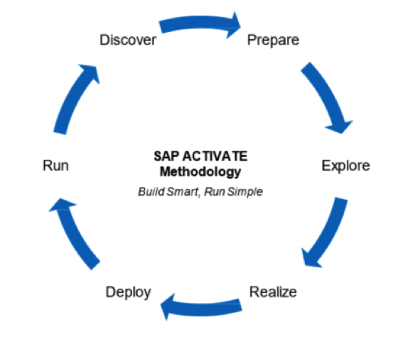
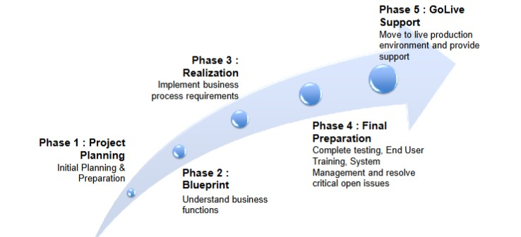
SAP Implementation and Methodology
SAP implementation is the method to implement the ERP Software in an organizations.
Common Methodology include ASAP (traditional) and SAP Activate (for S/4 HANA).
Accelerated SAP SAP Activate

Slide 10

Introduction to SAP PP
SAP PP is used for production planning, execution, and
resource optimization.
SAP PP integrates seamlessly with MM, SD, and QM modules to ensure efficient production workflows across departments.
Goal : Produce the right quantity, at the time, with minimum cost.
4M Planning
MAN : Human Labour involved in Production.
MACHINE : Equipment, tools and technologies involved in Production.
MATERIAL : Raw materials and components used to manufacture the products.
MONEY : Involves the financial resources requirement.

Slide 11
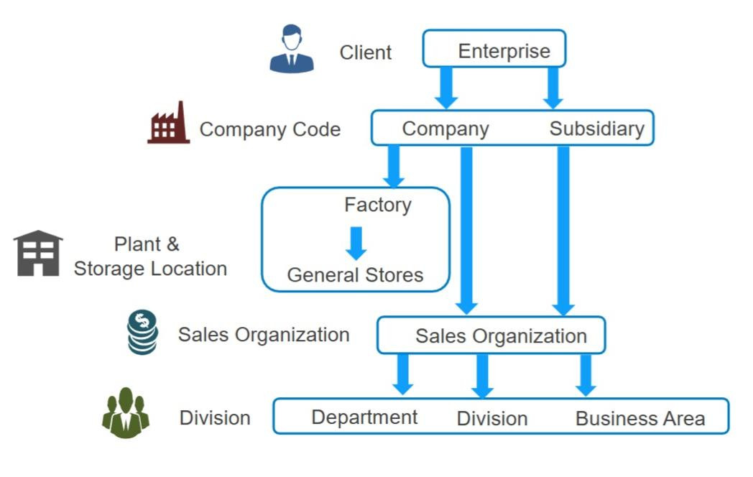
SAP PP Organizational Structure
Client – Highest level in SAP. Stores common data and separates one business environment from another.
Enterprise – Business group or parent organization (conceptual level).
Company Code – Legal entity. Used for financial accounting (P&L, Balance Sheet).
Plant ⭐ – Physical location where production happens. Most important level in SAP PP.
Storage Location – Sub-location inside a plant where materials are stored (RM, SFG, FG).
Sales Organization – Responsible for selling and distribution of products.
Division – Product line or category (e.g., Bicycle, Spare Parts).
Department / Business Area – Used for operational work or internal reporting.

Slide 12
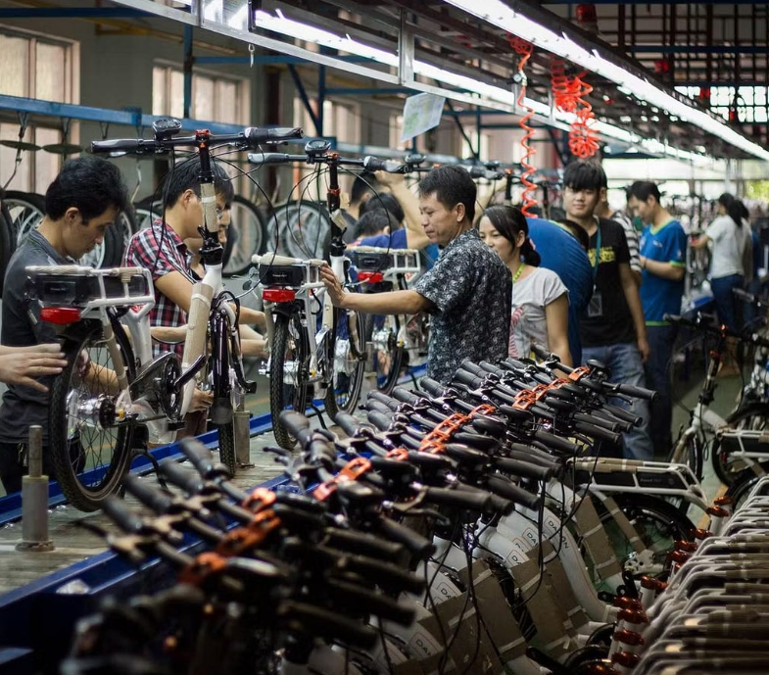
Why Bicycle as Product?
Bicycle is a manufactured Product.
Involves all SAP PP material types:
Raw Materials (ROH)
Semi-Finished Products (HALB)
Finished Product (FERT)
Packing Materials (VERP)
Supports Make to stock & Make to Order
Standard Bicycle – Make to Stock
Customized Bicycle – Make to Order
This product is easy to understand end-to-end SAP PP flow.

Slide 13
PRODUCT OVERVIEW – BICYCLE
Manufactured Product The bicycle is produced by assembling multiple components (frame, wheels, handlebar, seat, chain, brakes, pedals).
Target: 1,000 bicycles / month
Components: Frame Assembly, Wheel Assembly (2 wheels), Handlebar Assembly, Seat Assembly, Chain, Pedals, Brakes
Per day production: 33 bicycles Shifts: 2 (A, B, C)
Production per week: (33 × 7) = 231 bicycles
Production per year: (1,000 × 12) = 12,000 bicycles

Slide 14
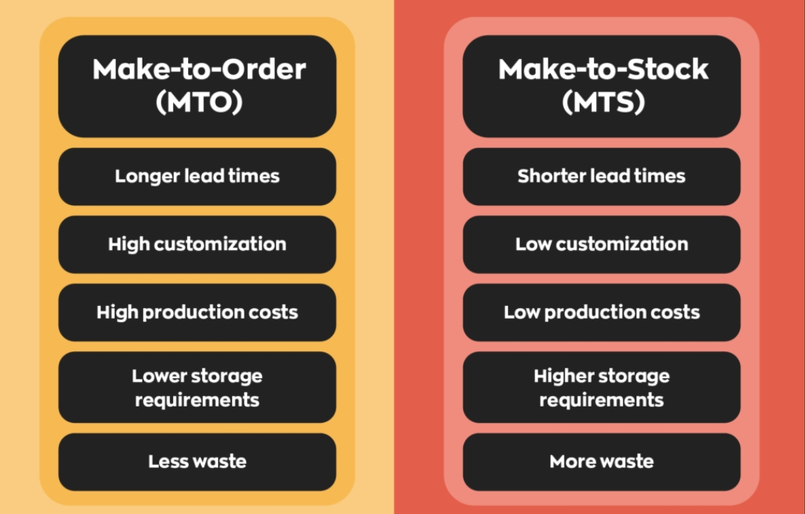
Make to Stock (MTS)
Production is done before customer order, based on forecast.
In Bicycle:
Standard models
Fixed color & size
Stored in warehouse
Make to Order (MTO)
Production starts after receiving customer order.
In Bicycle:
Custom colors, gears, frame size.
Premium / racing bicycles

Slide 15
Manufacturing Process
Point | Discrete Manufacturing | Process Manufacturing | Repetitive Manufacturing (REM)
Industry | Automobile, Bicycle, Electronics | Chemical, Pharma, Paint, Food | High-volume industries like TV, Bottles, Fasteners
Product Nature | Countable items | Liquids / Powder / Batch-based | Repeated same product continuously
Order Type | Production Order | Process Order | No individual order; Rate-based production
BOM Type | Material BOM | Recipe/Formula BOM | Production Version with Rate Routing
Routing / Instructions | Routing | Master Recipe | Rate Routing
Batch Management | Optional | Mandatory (required for batch traceability) | Usually not used
Confirmation | Order-wise confirmation | Phase-wise confirmation | Backflush-based; minimal confirmations
Costing Method | Order-based costing | Order costing + Co-product costing | Period-based costing
Product Variability | High — models, variants change | Specific formulation-based | Low — stable, repeated products
Production Flow | Starts/ends per order | Continuous or batch process | Continuous, long-run production
Use Case | Cars, machinery, appliances | Drugs, beverages, chemicals | Nuts, bolts, plastic bottles, consumer goods

Slide 16
Bicycle Variants
Based on Power Type
Manual Bicycle
Electric Bicycle (E-Bike)
Based on Gear System
Non-Geared
Geared
Brake System
Rod
V-Brake
Disc
Frame Type
Steel
Aluminum

Slide 17
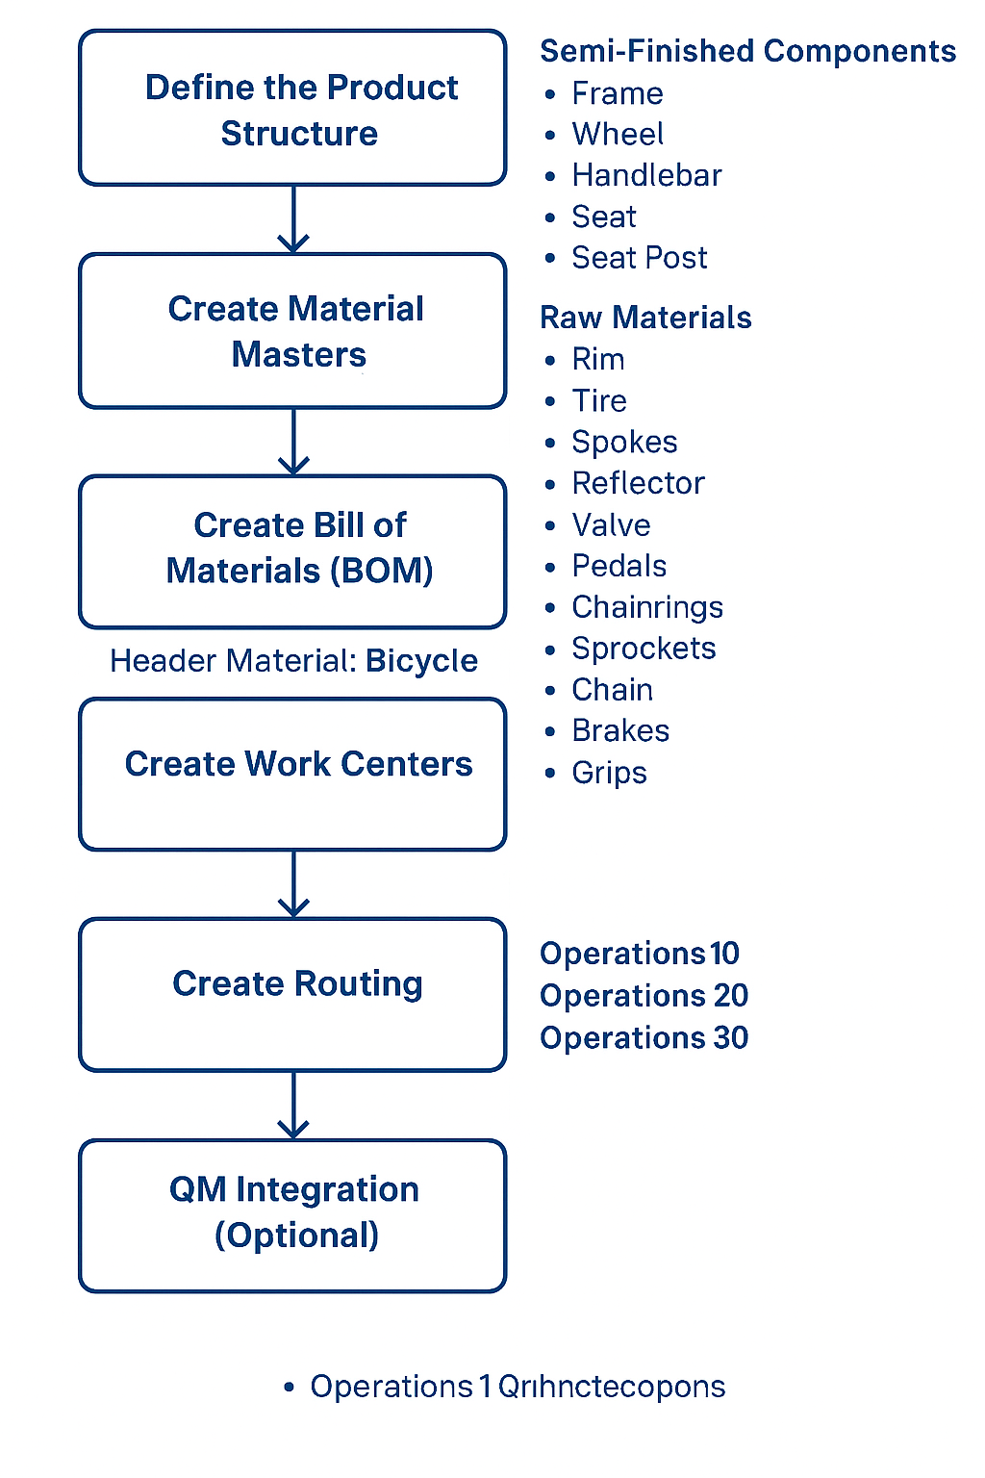
MASTER DATA USED IN PRODUCTION PLANNING
MATERIAL MASTER
BOM
ROUTING
WORK CENTER
PRODUCTION VERSION

Slide 18
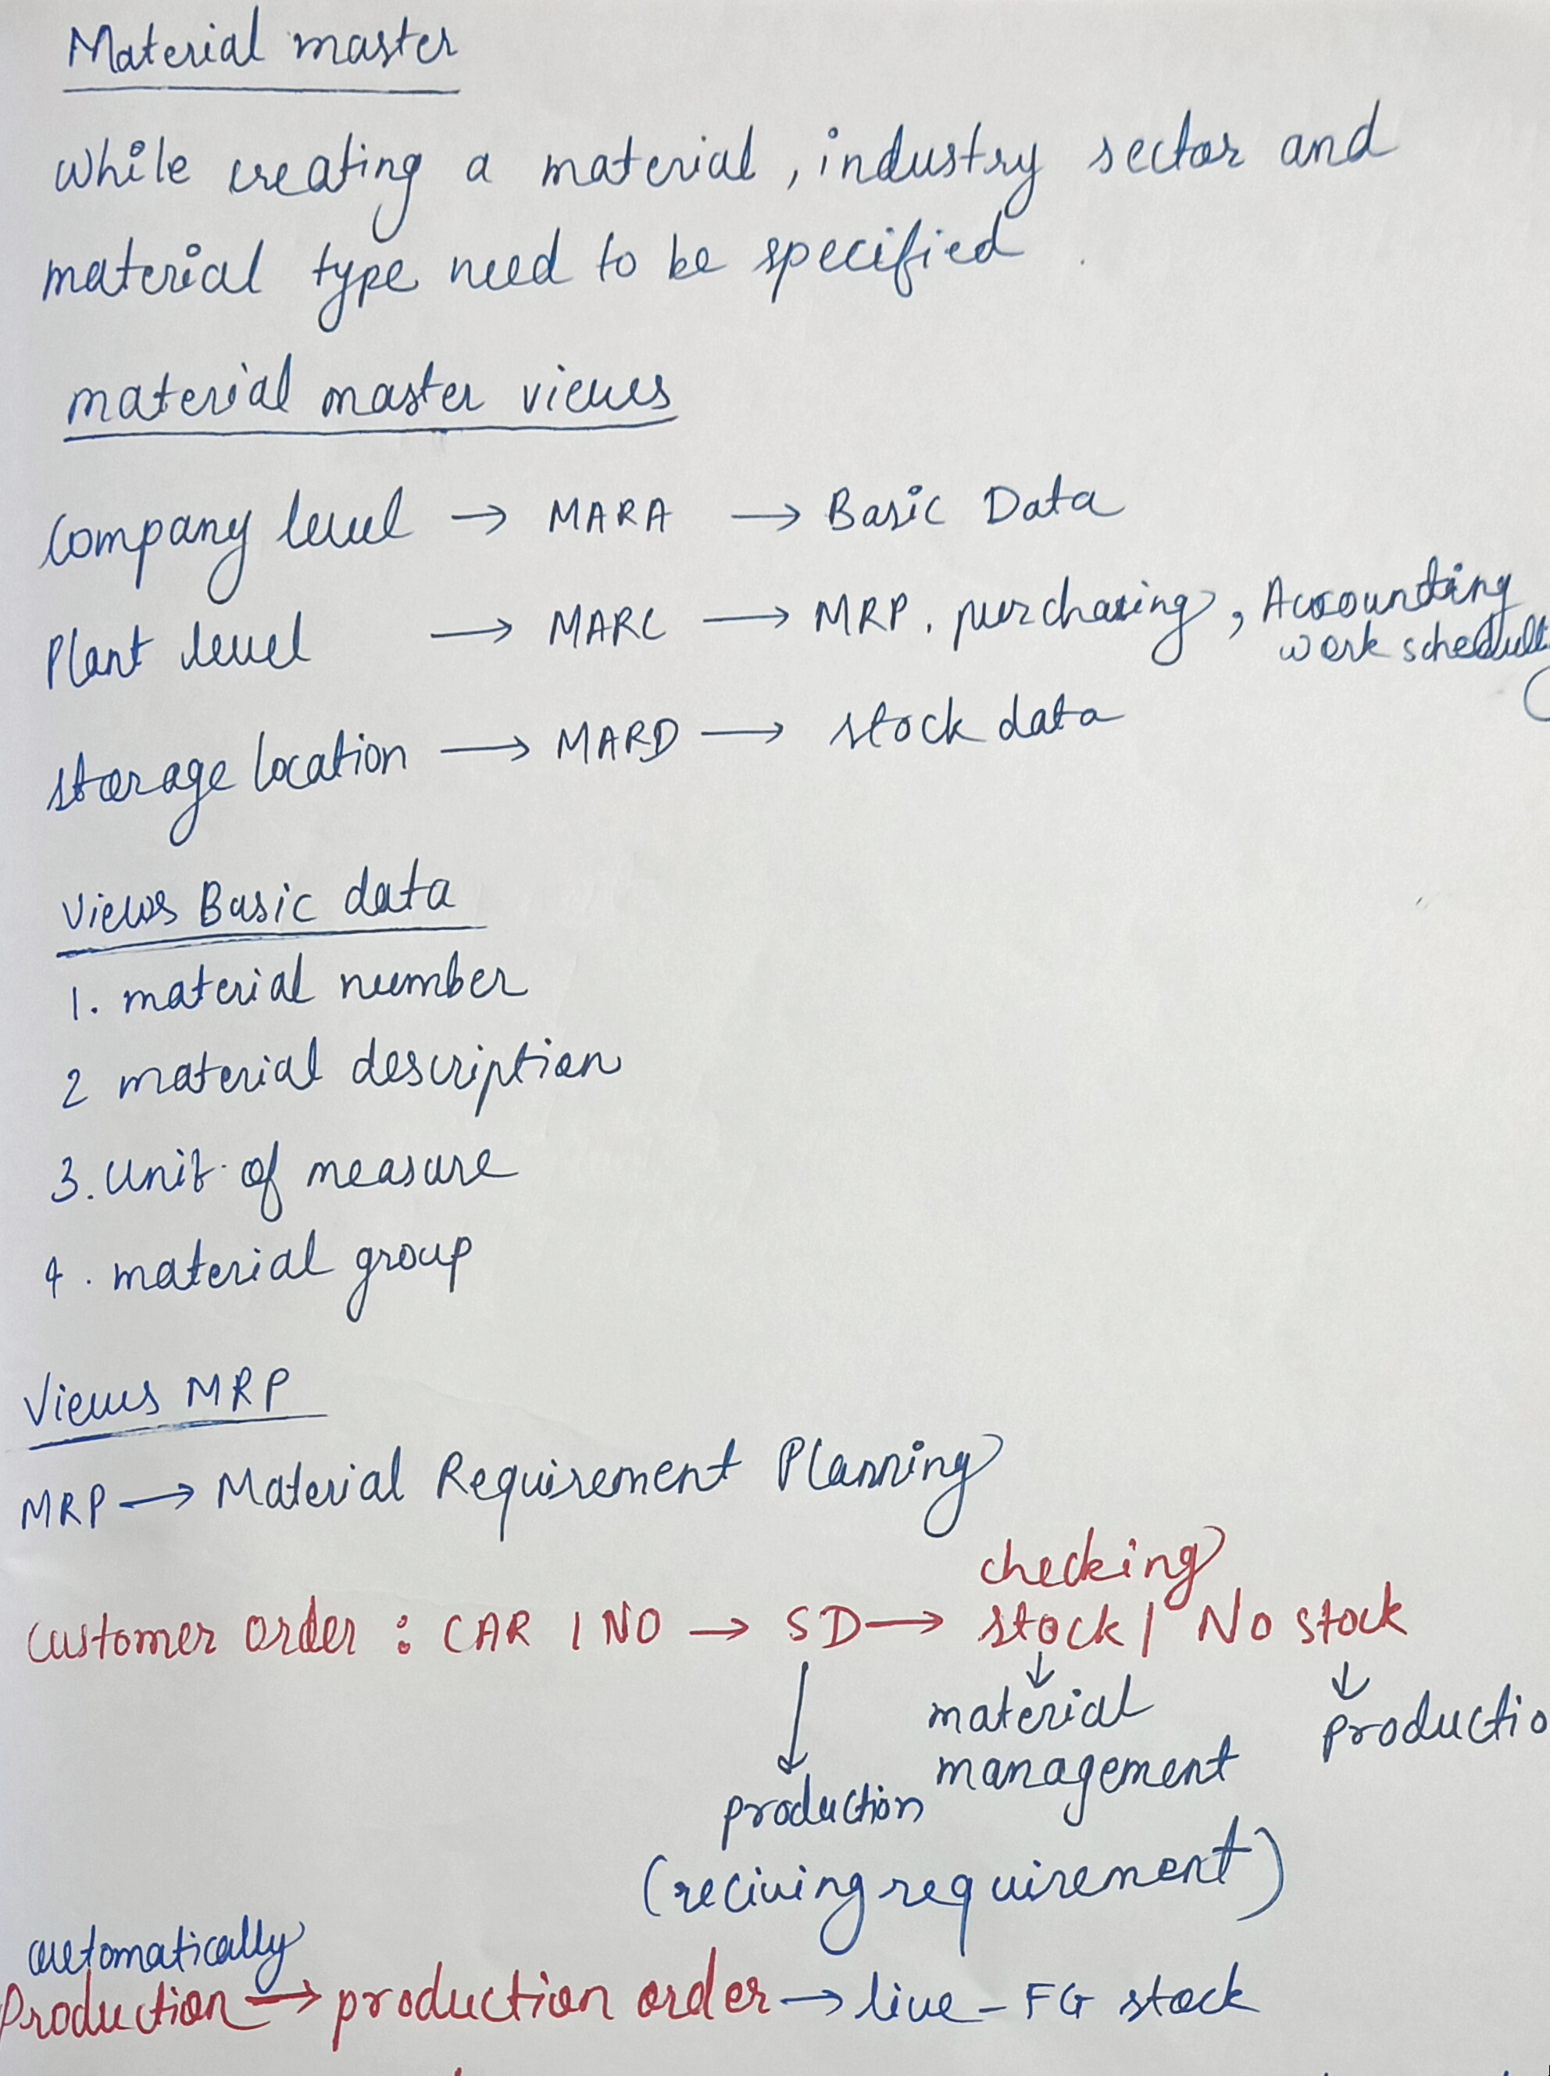
What is Material Master ?
Material Master is a central master data record in SAP.
Material master contains information related to different material types like finished product, raw material. Material master can be used for identifying a product, purchase material, goods issue or good receipt, MRP, and production confirmation.
For Material master data, use T-code: MM01 or go to Logistics → Production → Master Data → Material Master → Material → Create (General) → immediately
Material Master Transaction Codes
T-Code | Description
MM01 | Create Material
MM02 | Change Material
MM03 | Display Material
MM04 | Display Changes
MM06 | Flag material for deletion

Slide 19
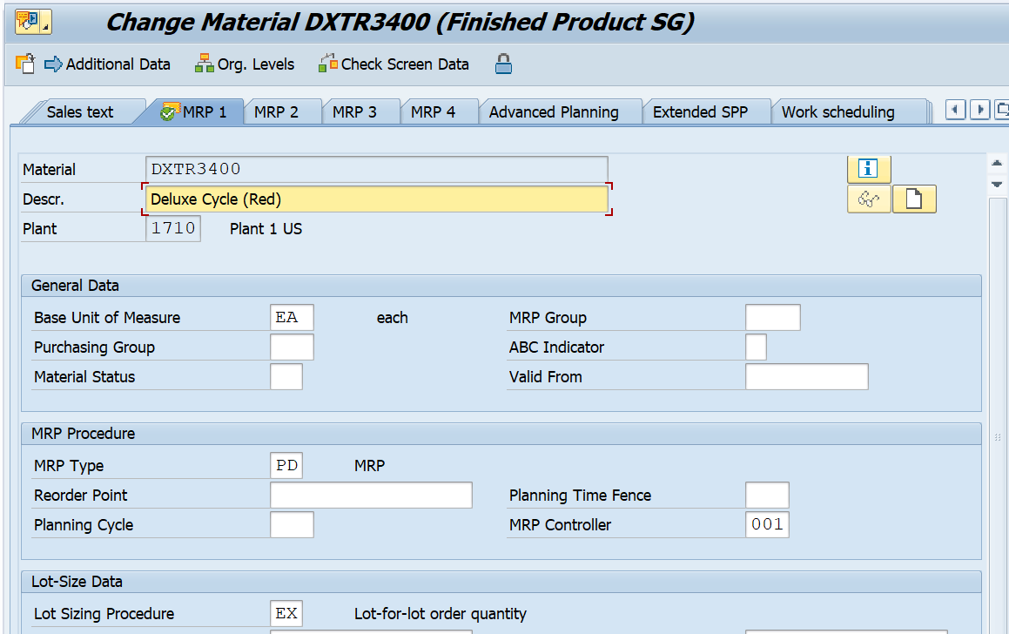
Creation Of MM
Material master contain entire information about all material in company where it is procured, produceand sales etc​
In simple terms, it is the central repository of information about material whether it is ROH, HALB OR vFERT.​
Raw Material (ROH) : Materials which can be obtained naturally and have not undergone any processing transformation.​​​
Semifinished material (HALB) : Materials that has been processed but is not yet ready for sale.​​​
Finished material (FERT) : Materials that are fully manufactured and ready to sell.​

Slide 20
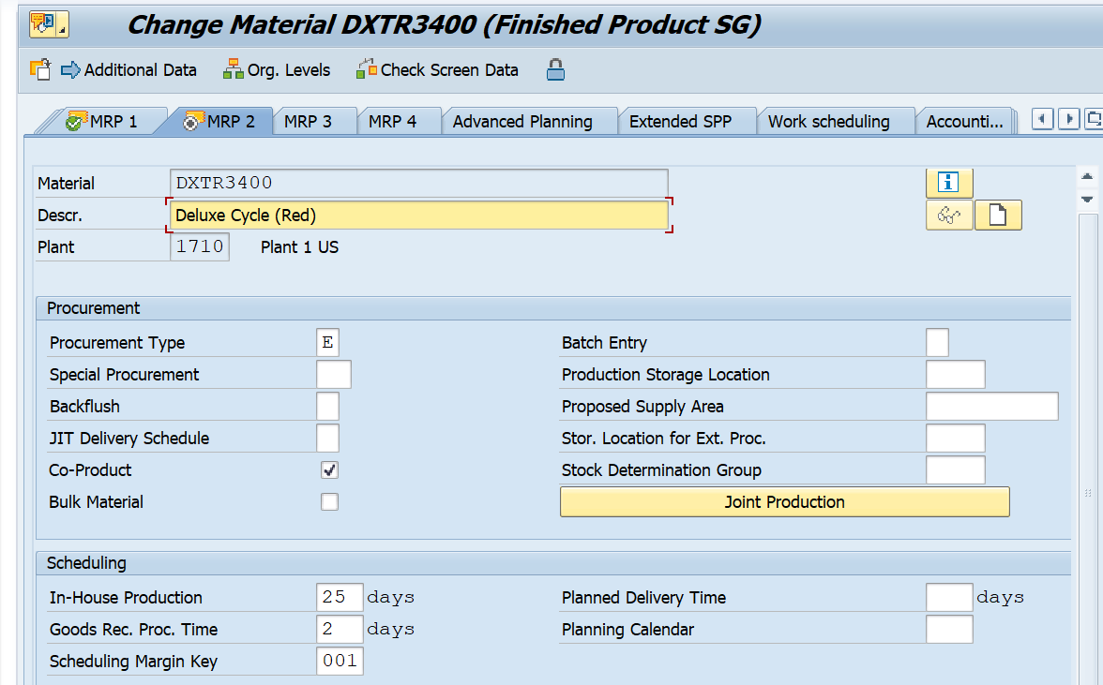
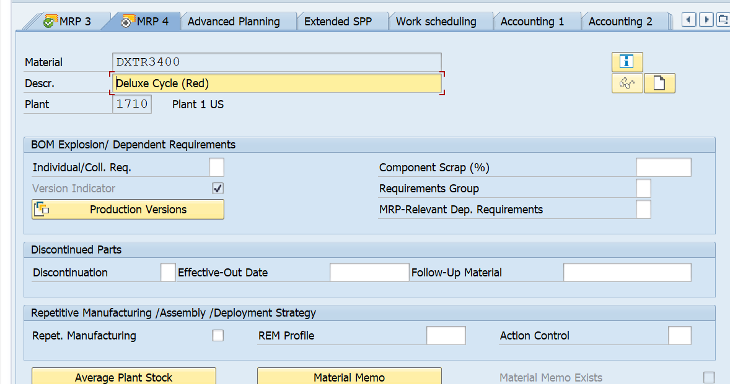
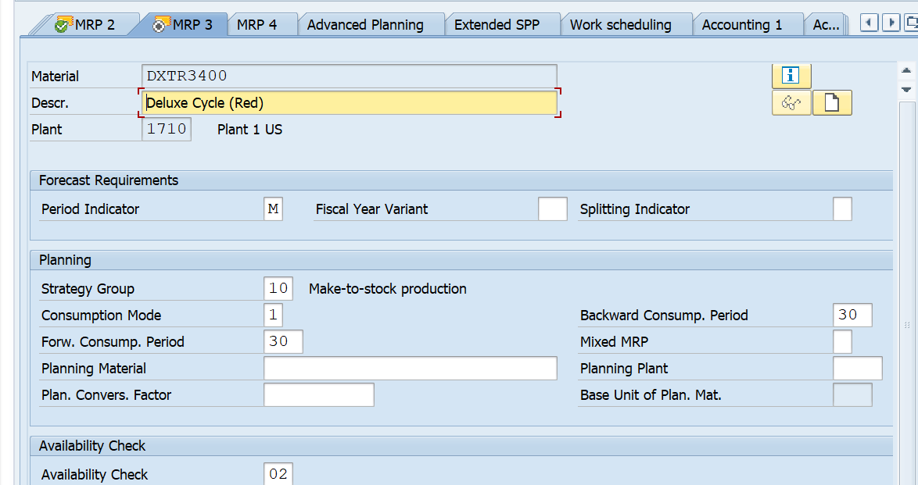
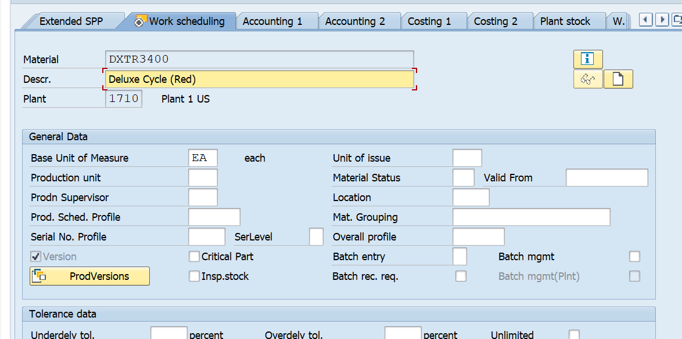

Slide 21
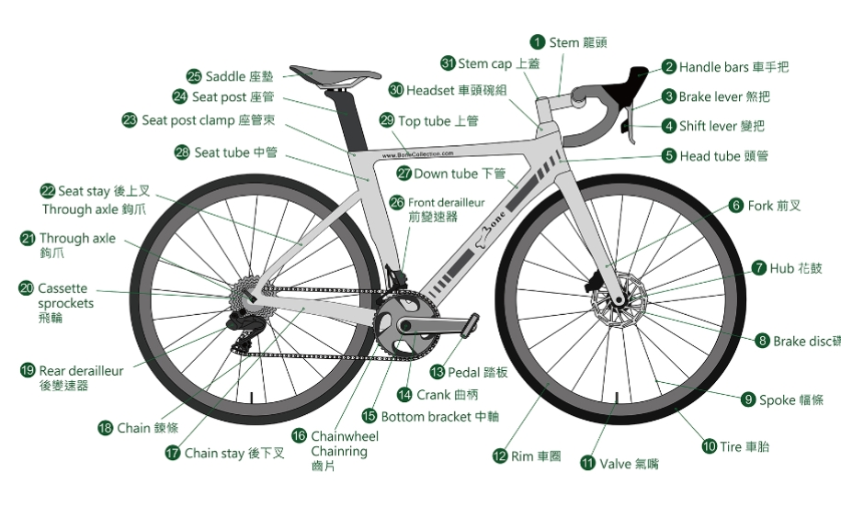
Raw Materials

Slide 22
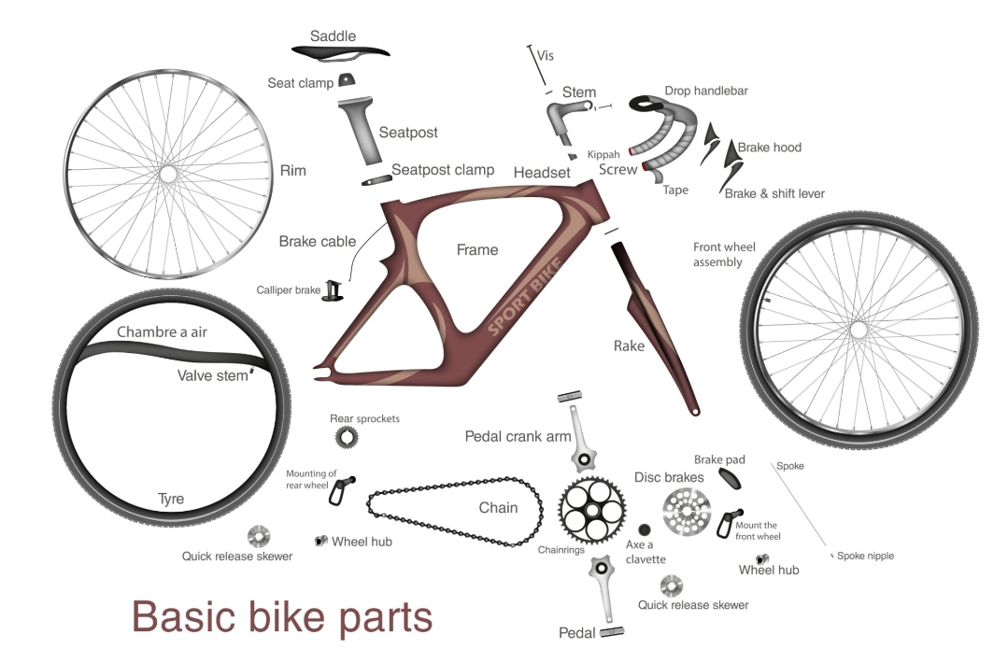
Semi-Finished Products (HALB)

Slide 23
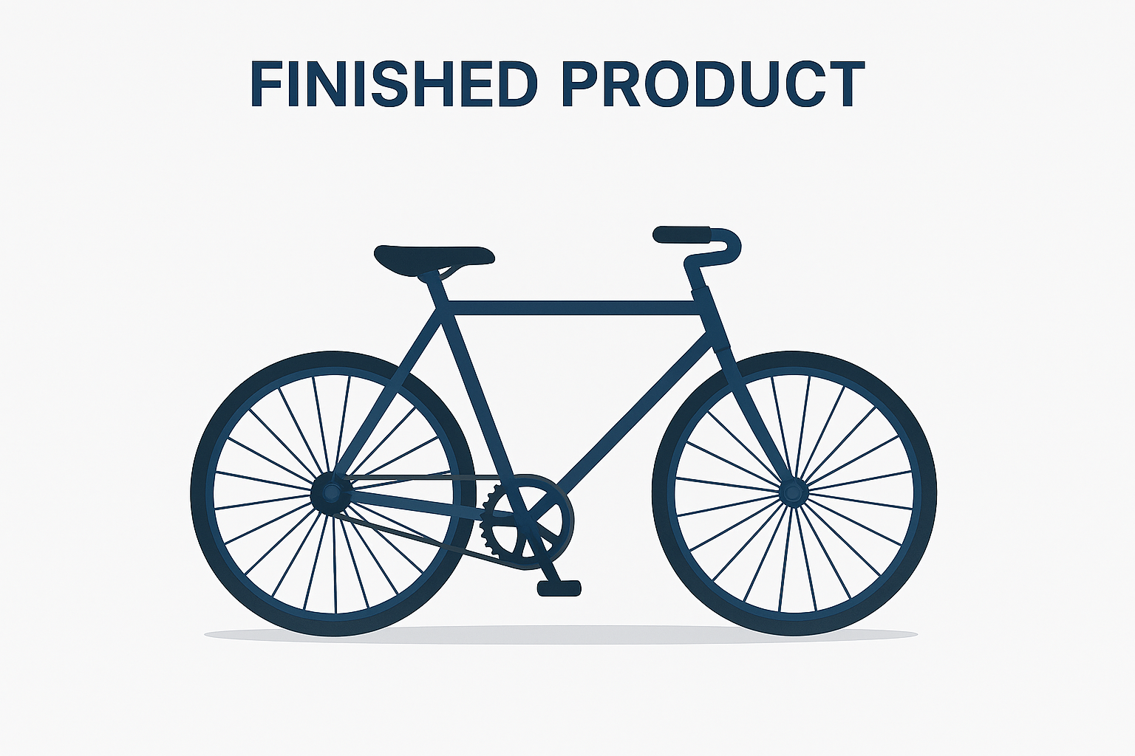
Item | Component | Material Type
10 | Frame Assembly | HALB
20 | Wheel Assembly | HALB
30 | Handlebar Assembly | HALB
40 | Seat Assembly | HALB
50 | Brake Assembly | HALB
60 | Gear Assembly | HALB
70 | Chain | ROH
80 | Pedals | ROH
90 | Nuts & bolts | ROH
100 | Carton Box | VERP
110 | Thermocol / Foam | ROH
120 | Bubble Wrap | ROH

Slide 24
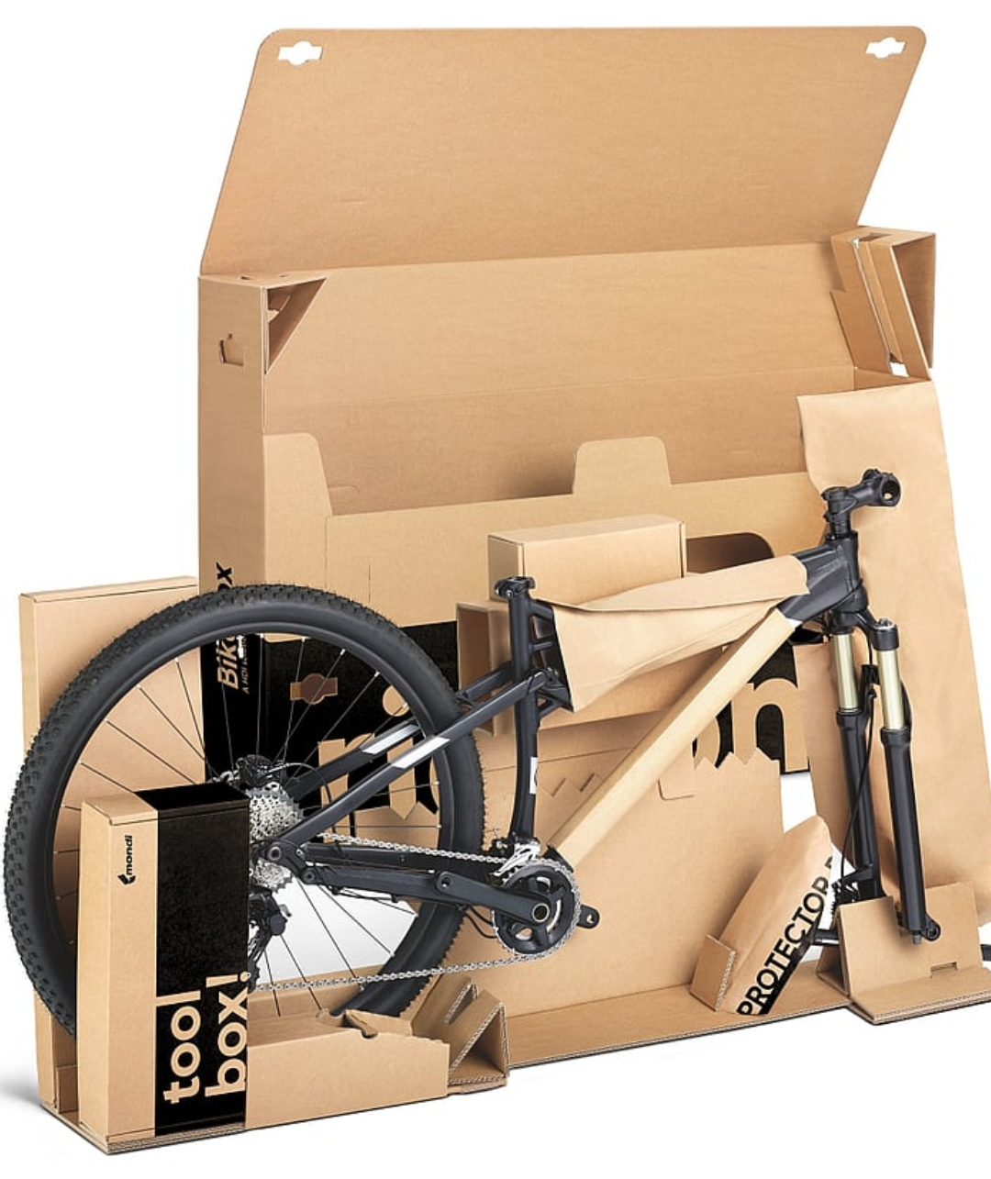
Packing Materials
Packaging Type
Corrugated boxes for frame and components
Bubble wrap for delicate parts (gears, brakes)
Foam padding for wheels and handlebar
Dimensions & Weight
Box size (e.g., 150 cm x 30 cm x 80 cm)
Approx. weight of packaged bicycle
Labeling & Markings
Product name and SKU
Handling instructions (e.g., “Fragile”, “This Side Up”)
Barcode for inventory tracking
Sustainability
Eco-friendly packaging options
Compliance with environmental standards
Visual Diagram
Show an image of the bicycle inside the packaging
Highlight protective layers and arrangement

Slide 25
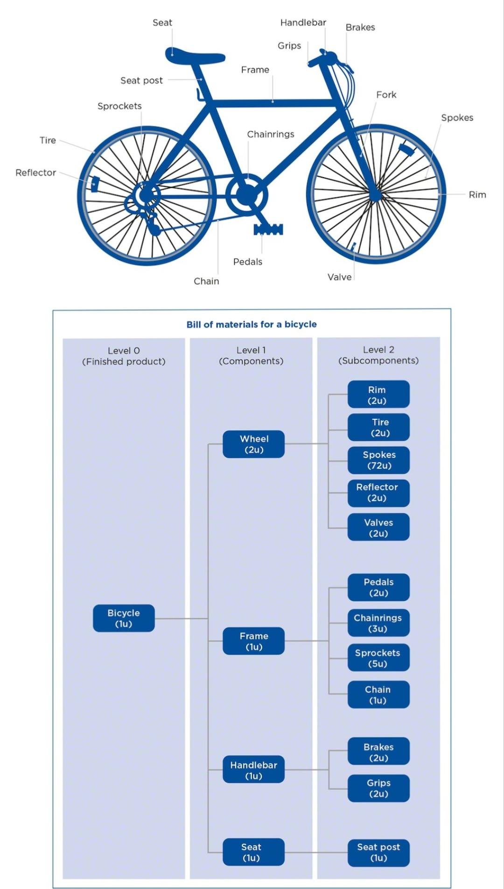
Bill Of Material (BOM)
Bill of materials master data is related to material requirement planning and provides the list of components to produce the product.
To produce a product with different variants, you can create super Bills of Material that has a list of components to manufacture different variants of a product. Selection of component depends on the details mentioned in the planning order. You can create up to 99 Bills of Material.

Slide 26
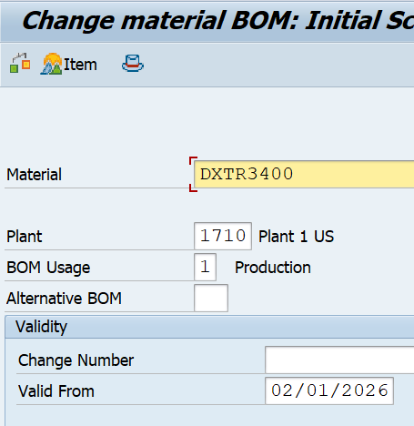
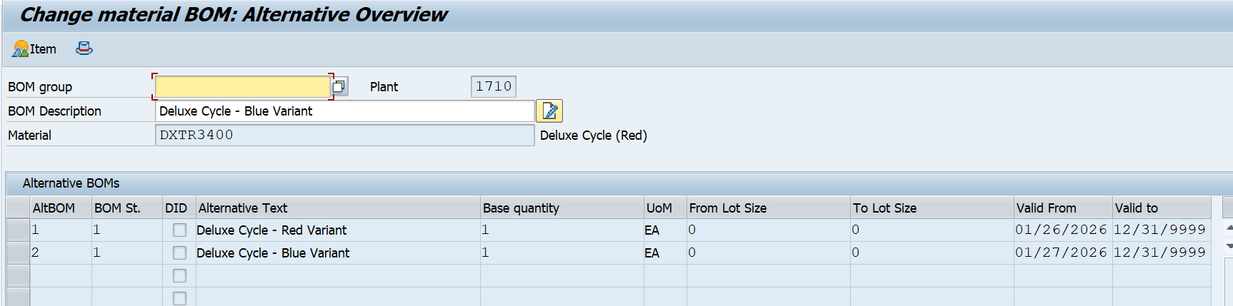
Select the following details −
Material
Plant
BOM usage (usage 1 is production)
By default, it takes the current date as Valid from. You can select the date as per your requirement.

Slide 27
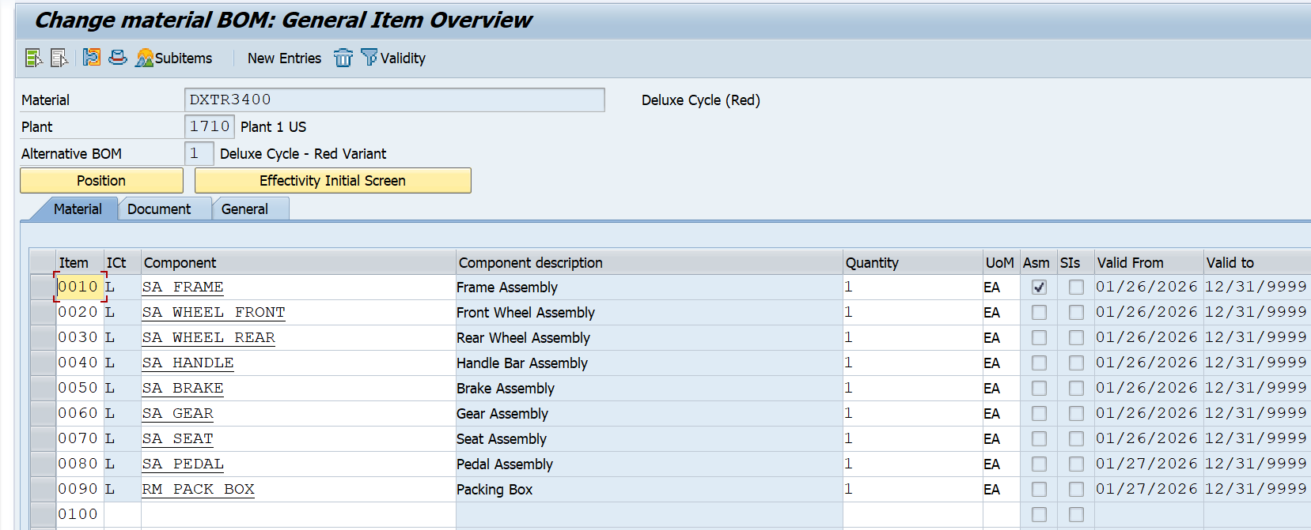
In the next window, enter Item category L. L shows the stock item and N shows nonstock item.
Enter the following details −
Component name
Quantity.
Types of BOM
There are two types of BOMs −
Material BOM
When a BOM is created for a material, it is known as a material BOM in SAP. Material BOMs are mainly used to represent the structure of products manufactured within your company.
Sales Order BOM
Sales Order BOM is used when you specially tailor the make-to-order production of products as per the requirements of the customers. To meet the customer requirements, you make sales order specific modifications to various assemblies.

Slide 28
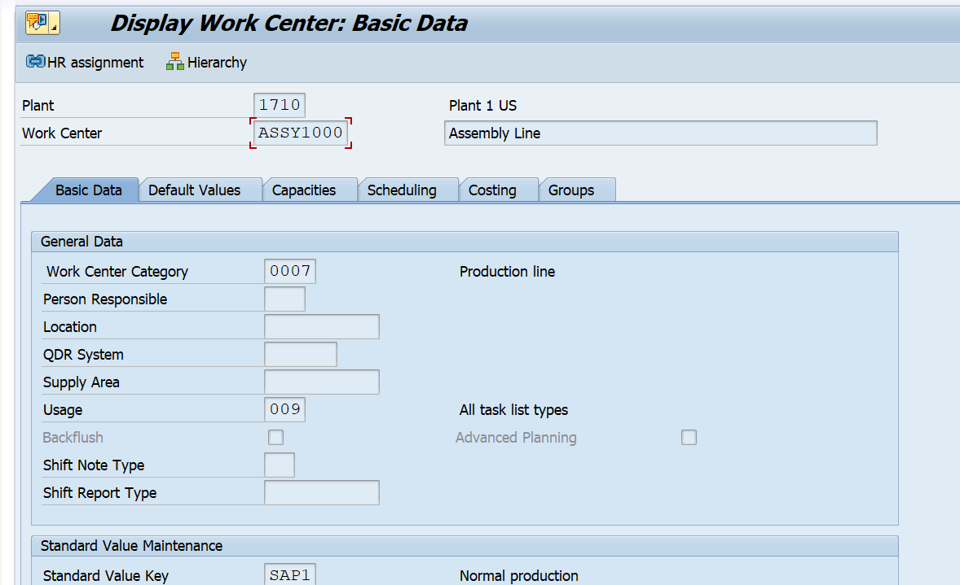
WORK CENTER
Work center consists of master data related to routing of products. It contains data related to scheduling, capacity planning, and production costing.
For Deluxe Cycle:
ASSY1000,INSP1000,PACK1000
Enter the following details −
Work Center description.
Person responsible code for that work center.
Physical location where the work center is located in the plant.
Enter usage as 009: Work Center is valid for all task list types such as production routing, maintenance task list, etc.
Enter the standard Value key which contains different activity types used for standard cost calculation.

Slide 29
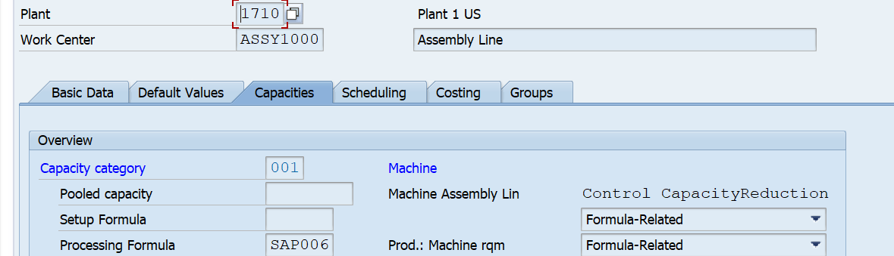
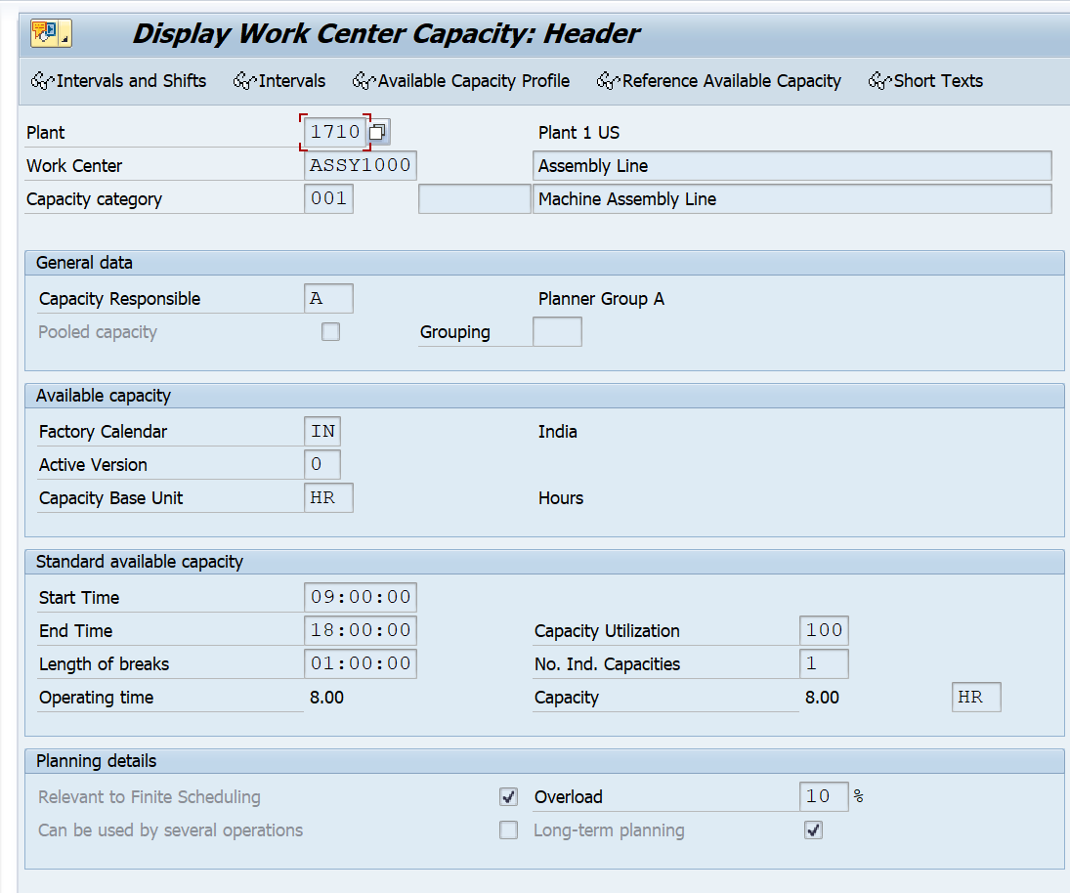
Go to Capacities tab, enter the following details −
To represent a machine category, enter capacity category 001.
To calculate available capacity, enter Processing formula as: SAP006= (operation quantity *machine time)/ base quantity
Click the Capacity tab at the bottom and enter the following details −
Enter the capacity description.
Enter details about Input capacity planner group, which is responsible for machine capacity.
Enter the factory calendar ID, which has public holidays listed for your plant. On holidays capacity for that work center would be zero.

Slide 30
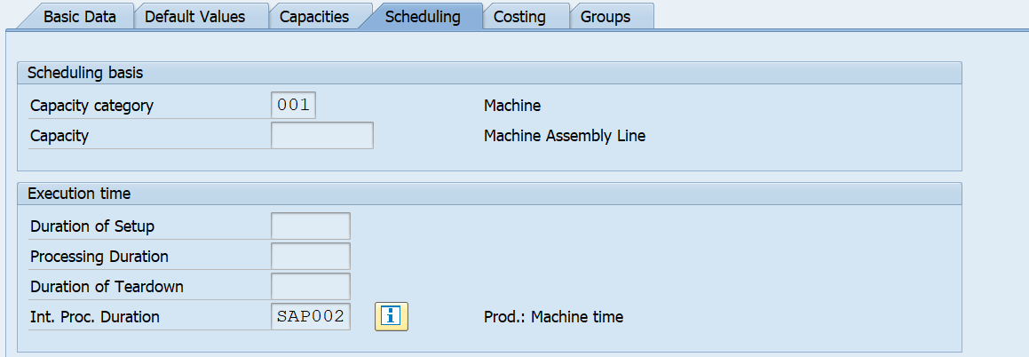
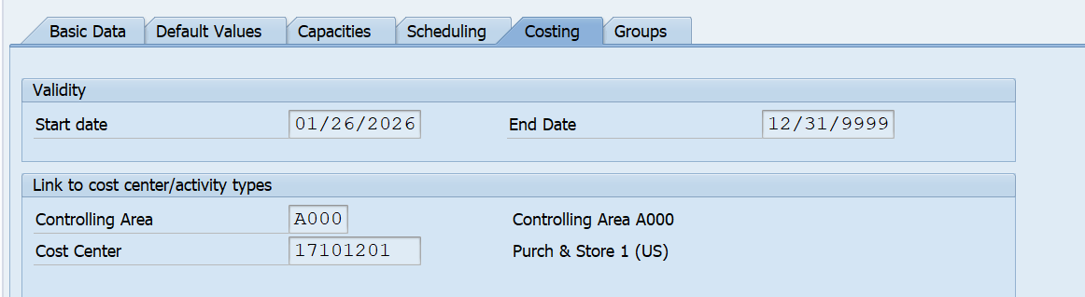
Click the back button at the top of the screen and go to Scheduling tab. To enter machine category, enter 001 as Capacity category.
To calculate scheduling time, enter SAP002 as input processing formula.
Go to Costing tab, and enter the following details −
Start and Finish date. This shows the validity date of the cost center.
The cost center to book the operation cost.
Click the save icon at the top and you will get a confirmation, Work center ASSY1000 in plant 1710 was created.

Slide 31
Handling Work Center Unavailability
MRP detects overload → Capacity Planning → Reschedule → Alternative Work Center → Subcontract → Create New Work Center → Overtime/Shift Adjustment
Best Practices Tips:
Always maintain alternative work centers in routing for flexibility.
Use capacity leveling tools before creating new work centers.
Subcontract only when internal capacity cannot meet demand.
Key SAP T-Codes:
CM01 – Capacity Overview
CM21 – Capacity Leveling
CR01 – Create Work Center
CA02 – Routing Change
ME21N – Purchase Order for Subcontracting

Slide 32
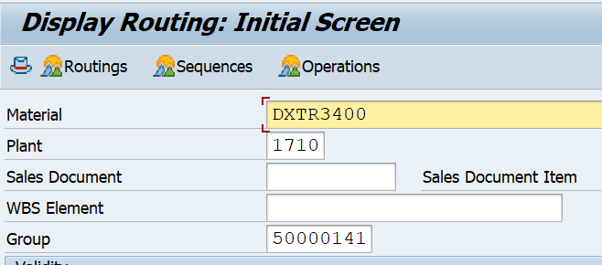
Routing (CA01)
A routing is defined by the routing group and the routing group counter. Moreover, the routing contains a reference to the material whose production is described by the routing.
Besides the standard sequence, it can also have parallel or alternative sequences. Alongside the standard values, the routing also contains time elements that are relevant for scheduling operations. Each operation in the routing may contain its own base quantity, to which these time elements may refer.

Slide 33
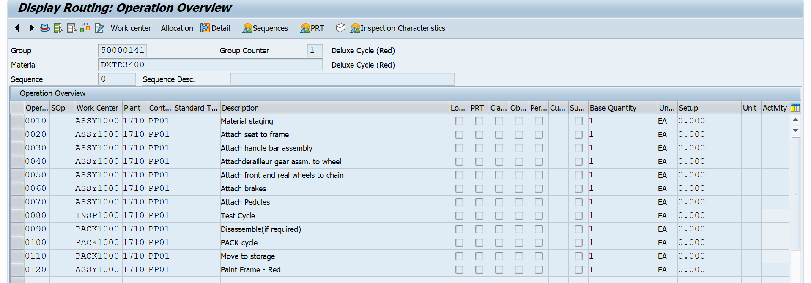
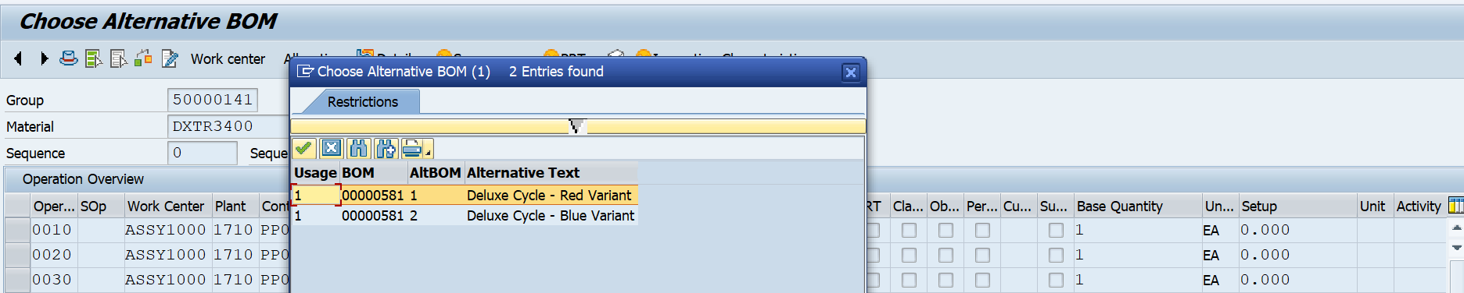

Slide 34
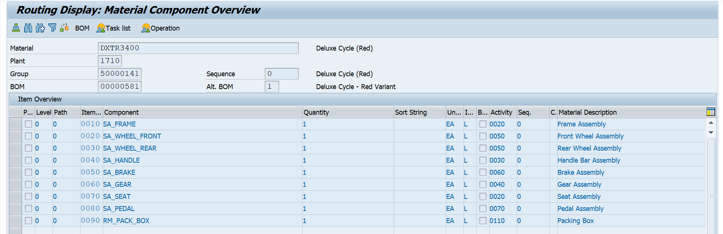
Select Allocation to display a list of all components.
Press Assignment. In the popup that appears, enter 0020 for Activity and confirm the entry with SAVE.
Apply the changes with SAVE . The system issues a message that the routing has been saved.

Slide 35
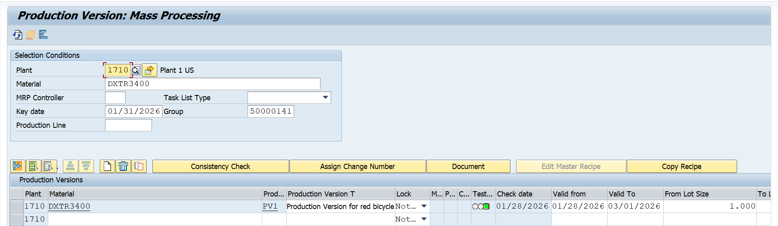
Production Version (C223)
What it is: Production Version is basically a combination of the BOM and task List(Routing).
Why it’s needed: MRP uses production version to know which BOM and routing to apply.

Slide 36
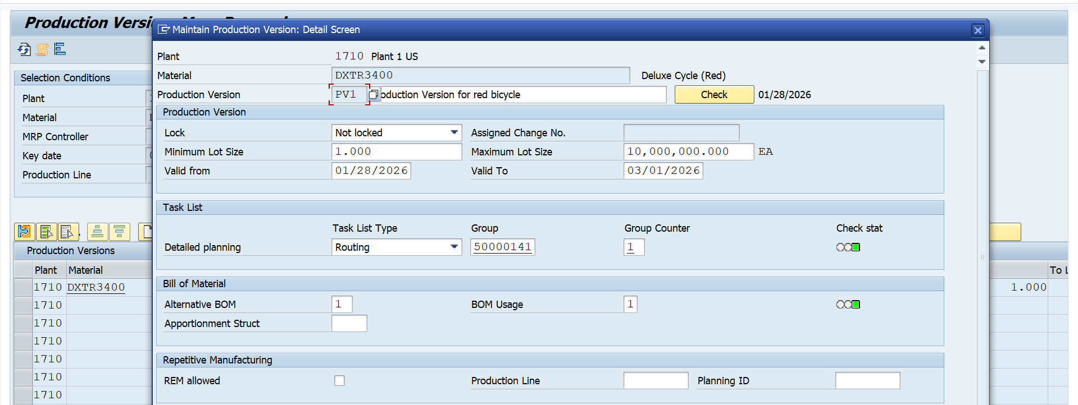
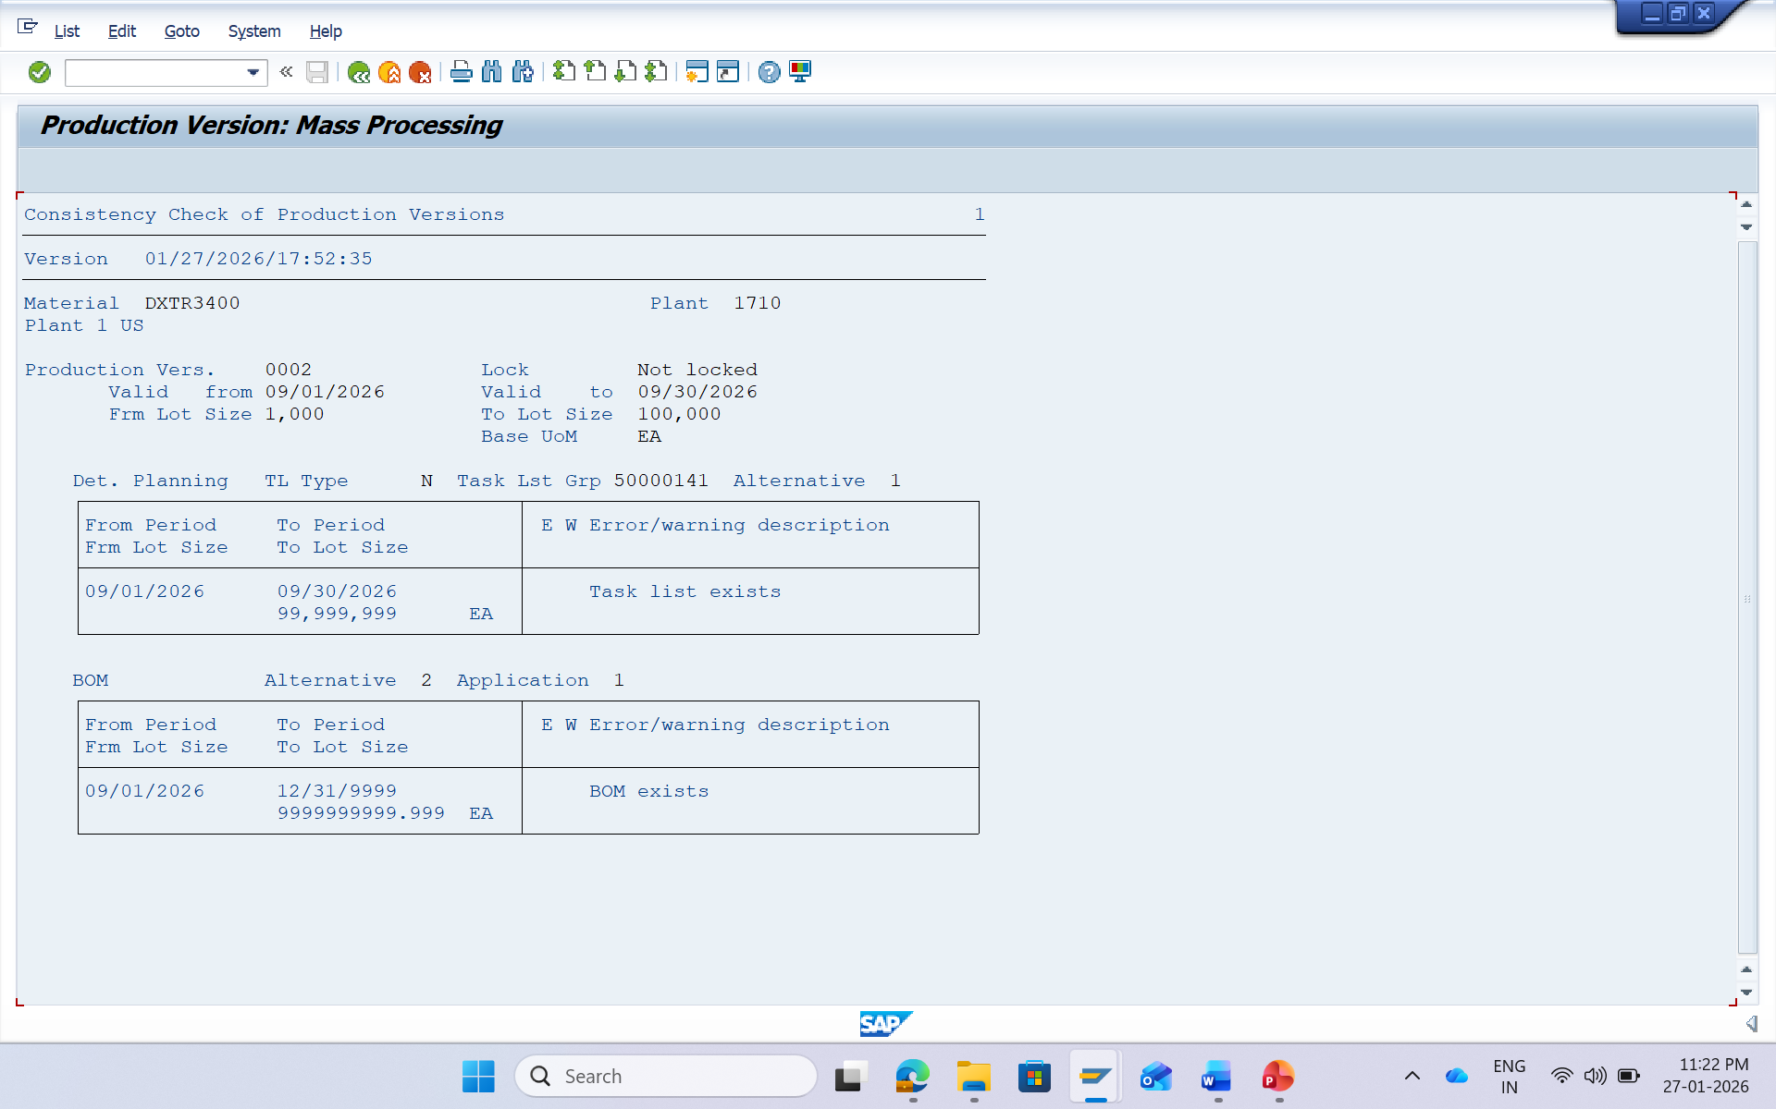

Slide 37
Demand Management
Transactional System-Driven Process
Overview - Demand Management
Types of Requirements
Planned independent requirements
Customer requirements
MRP Run
Stock & Requirement
Planed order convert into Production Order
Production order release
Goods Issues
Production Order Conformation
Goods Receipt

Slide 38
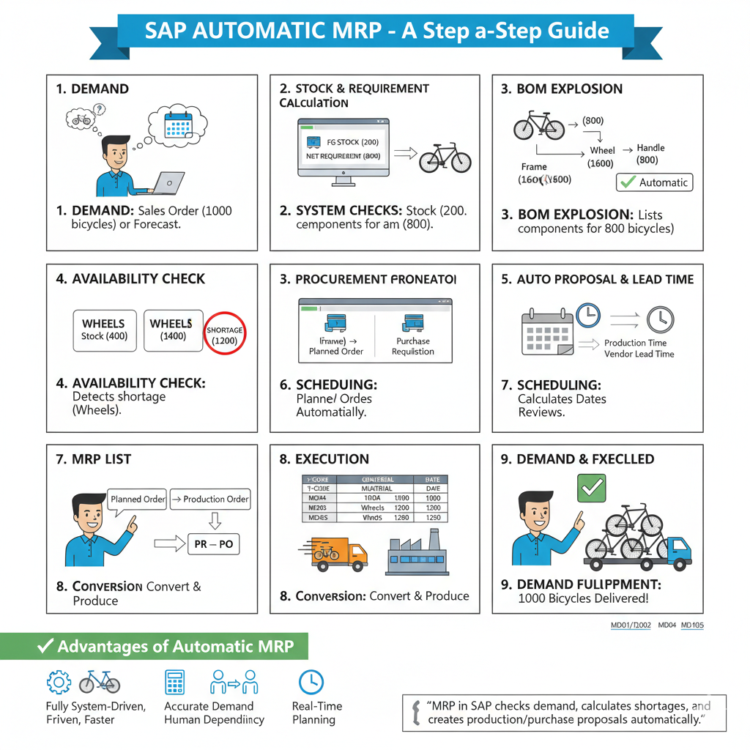

Slide 39
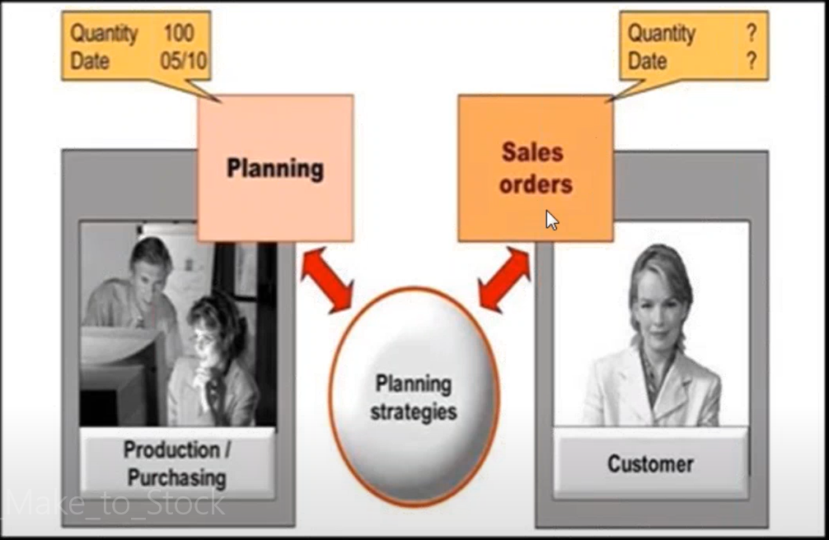
Overview - Demand Management
The function of Demand Management is to determine requirement quantities and delivery dates for finished products assemblies. Customer requirements are created in sales order management.
Demand Management is the link between top level requirements planning (eg: SOP, Material forecasting) with the Material requirement planning (MPS/MRP)

Slide 40
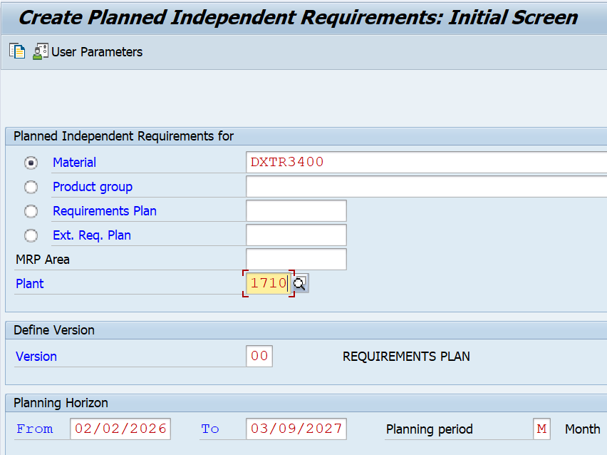
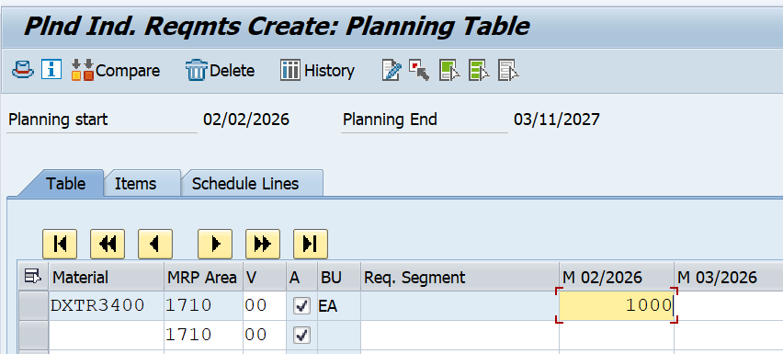
PIR (MD61)
The single material for which demand needs to be created.
MRP area and Plant Code.
Version as 00, which shows the active version and requirements would be considered in MRP run.
The planning horizon dates for which the demand needs to be created.
Planning period as month M.
Enter Version 00 and by default the Active checkbox is flagged, showing it is an active requirement and would be considered in MRP run.

Slide 41
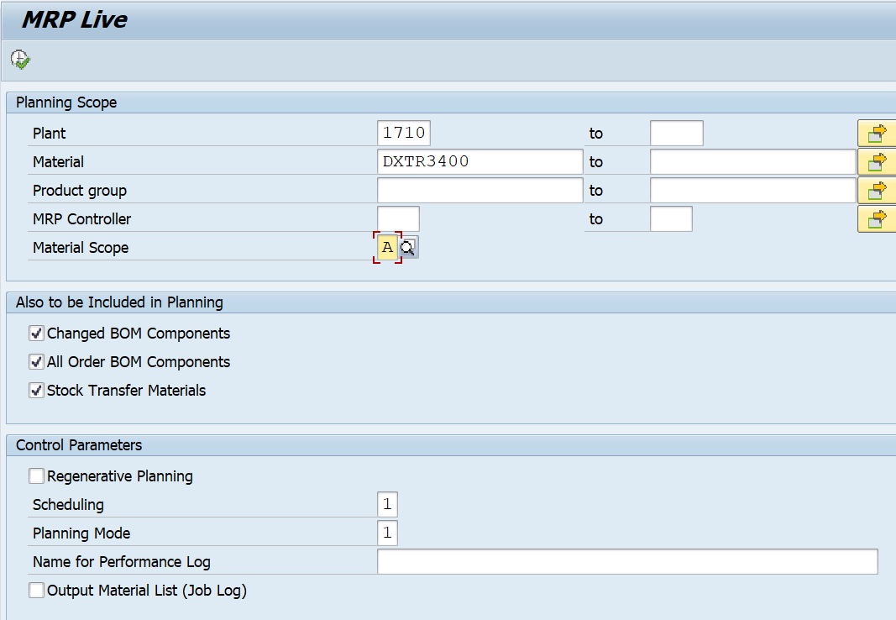
Material Requirement Planning(MD01N)
MRP run or planning run is an engine which is used to fill the demand and supply gap. Issues and Receipts are called MRP Elements. Issues include PIRs, dependent requirements, order reservations, sales orders, issuing stock transfer orders, etc. Receipts include production orders, purchase requisitions, purchase orders, open production orders, receiving stock transfer order, schedule lines, etc.

Slide 42
MRP T‑Codes
T‑Code | Name | Type of Planning | Scope | Processing Logic | Performance | Key Use Case
MD01 | Classic MRP Run | Total planning | Plant-wide (all materials) | Classic MRP logic, single-threaded | Slower compared to MD01N | Run full MRP for all materials in a plant
MD02 | Classic MRP – Single Item, Multi-Level | Single-material planning | One material, multi-level BOM | Classic MRP logic | Faster than MD01 (small scope) | Plan one material with all its BOM levels
MD03 | Classic MRP – Single Item, Single-Level | Single-level planning | One material, one level only | Classic MRP logic | Fastest among classic MRPs | Very quick check of planning for one material (no BOM explosion)
MD01N | MRP Live | Total planning (live) | Plant-wide or selection of materials | Runs on HANA in-memory; SQL-based; parallel pr

Slide 43
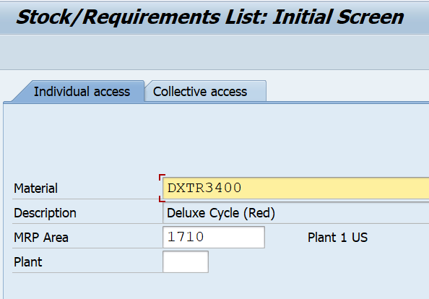
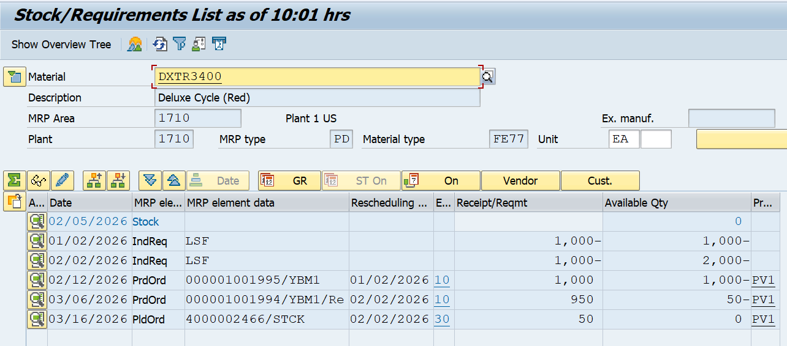
MRP Evaluation: Stock/Requirement List (MD04)
This is used to see current stock and planned receipts. Use T-code: MD04
BOM for material was exploded. Enter Production Order.

Slide 44
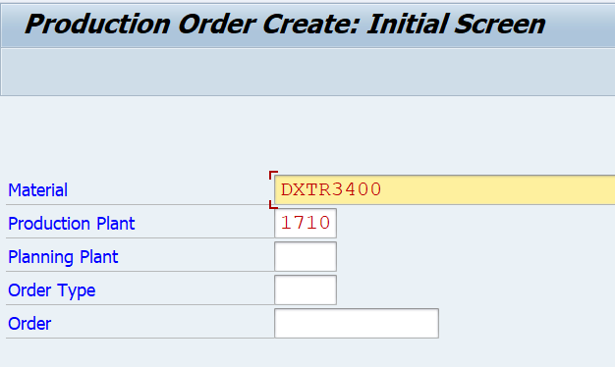
Creating a Production Order Directly from Stock Requirement List
Using Planned Order Number
Use T-Code: MD16
Use T-Code: CO01
The first step is to convert a planned order to a production order. When you create a Production Order, type is defined in SAP PP system.
To start the production process, it is necessary to issue a Production order. Till a production order is not released, the execution of production process does not start.
Issuing goods is required for providing the goods to execute the Production order. Once goods are issued, the document number can be updated in the system.
All the sub processes are executed in accordance with the required operations to confirm the production as per the Production order.
Material code for which the production order needs to be created.
Plant Code.

Slide 45
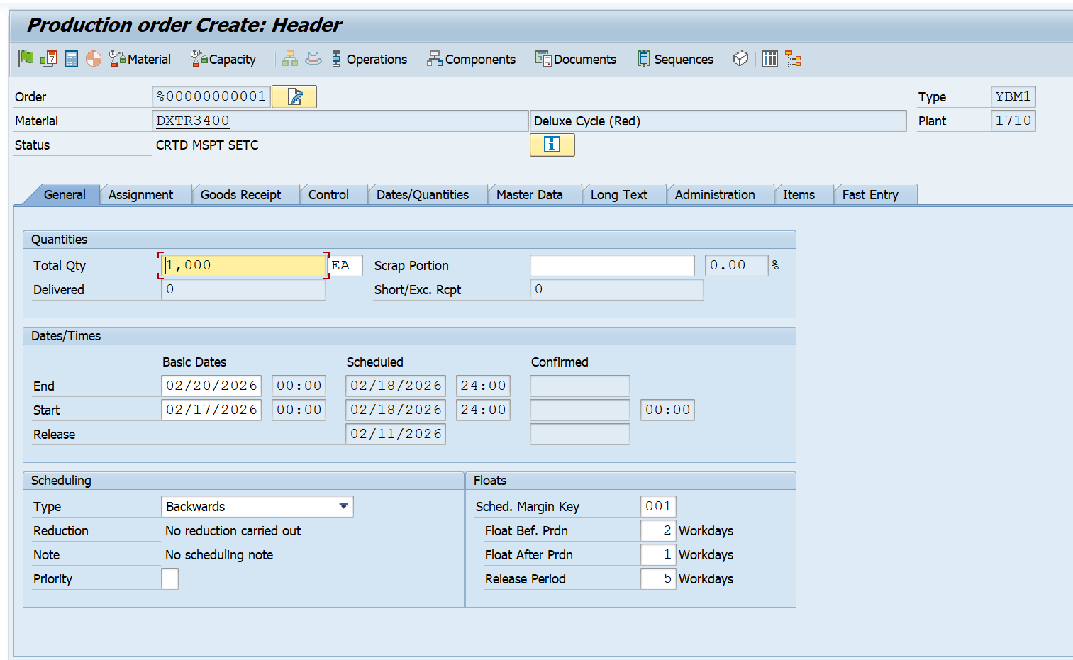
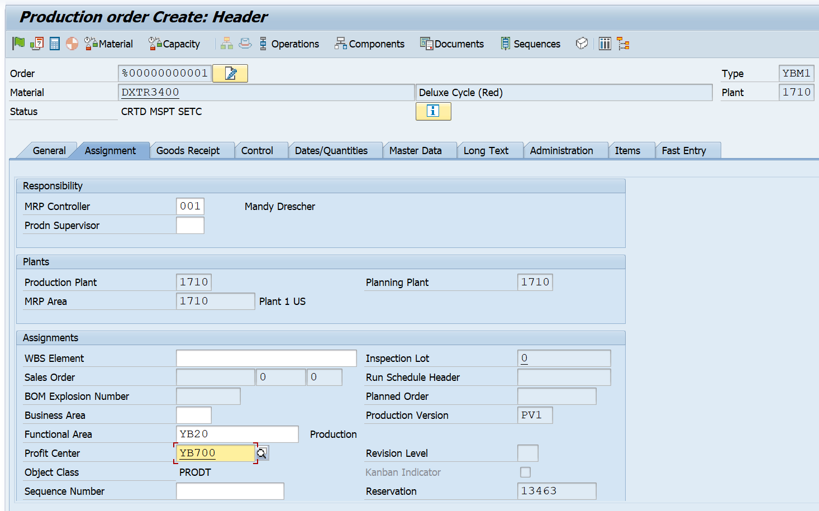
Production Orders
At this point, please note down the total quantity in your production order. We will need it later when confirming your order.
Click the tick mark at the top of the screen to confirm and the system will then copy BOM and Routing data in the order.
To release the order, click the Release flag at the top and you will get a message Release carried out.
Click the Material button to check material availability.
Production Order creation (CO01) → default is Backward Scheduling
You can switch to Forward Scheduling before releasing the order
Scheduling depends on routing, operation times, and work center capacity

Slide 46
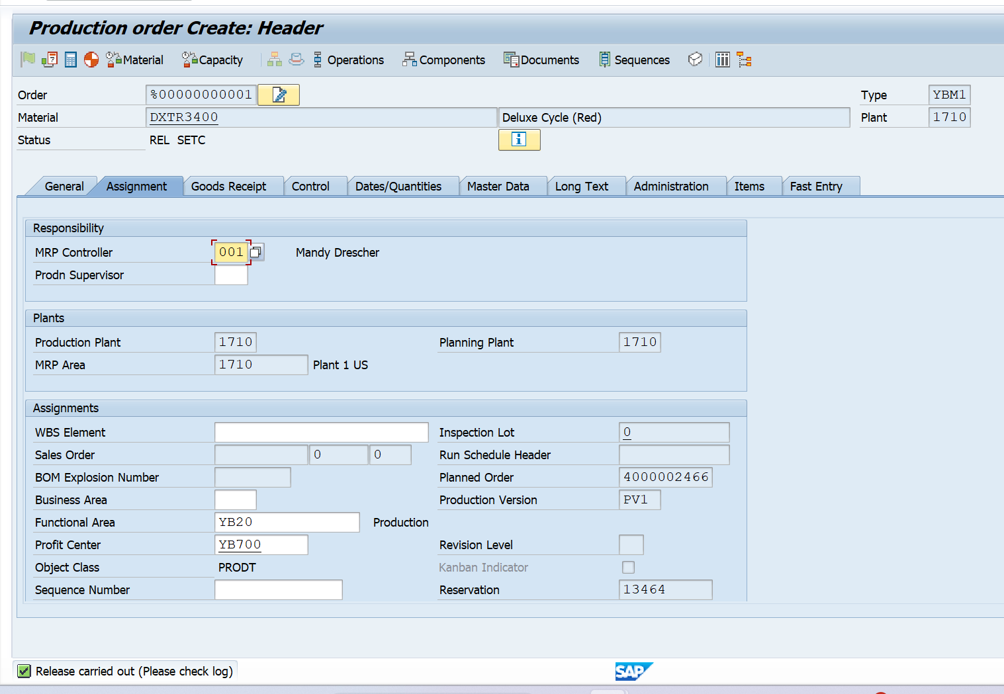
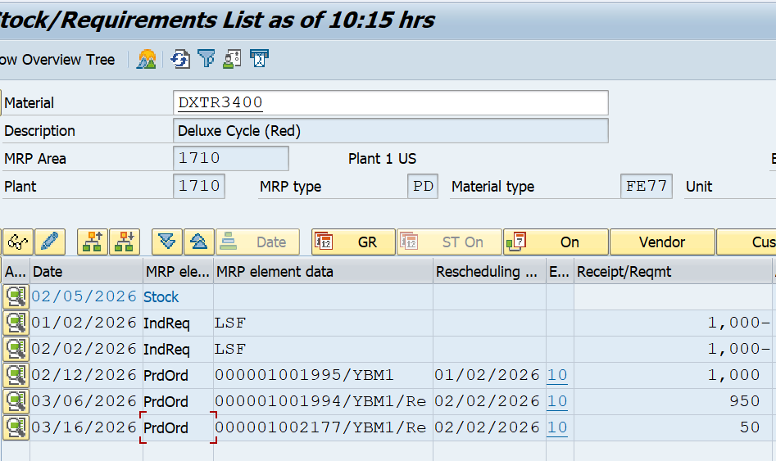
We will automatically return to the Stock/Requirements list. Select to refresh the list. The planned order PldOrd that you had selected is now available as a production order PrdOrd.

Slide 47
Goods Issue for Production Order
Goods Issue (GI) is the process of withdrawing materials from inventory and issuing them to a Production Order.
It represents the consumption of raw materials/semi‑finished materials during production.
GI reduces stock and updates the production order with actual component consumption.
For opening Goods Issue Transaction :
T-code: MB1A (classic) or MIGO (modern).
Purpose: Post GI for Production Order.
Impact:
Stock decreases in inventory.
Production Order gets updated with consumed materials.
Accounting entries posted (material consumption).
Mandatory Step: Without GI, production order cannot be completed.

Slide 48
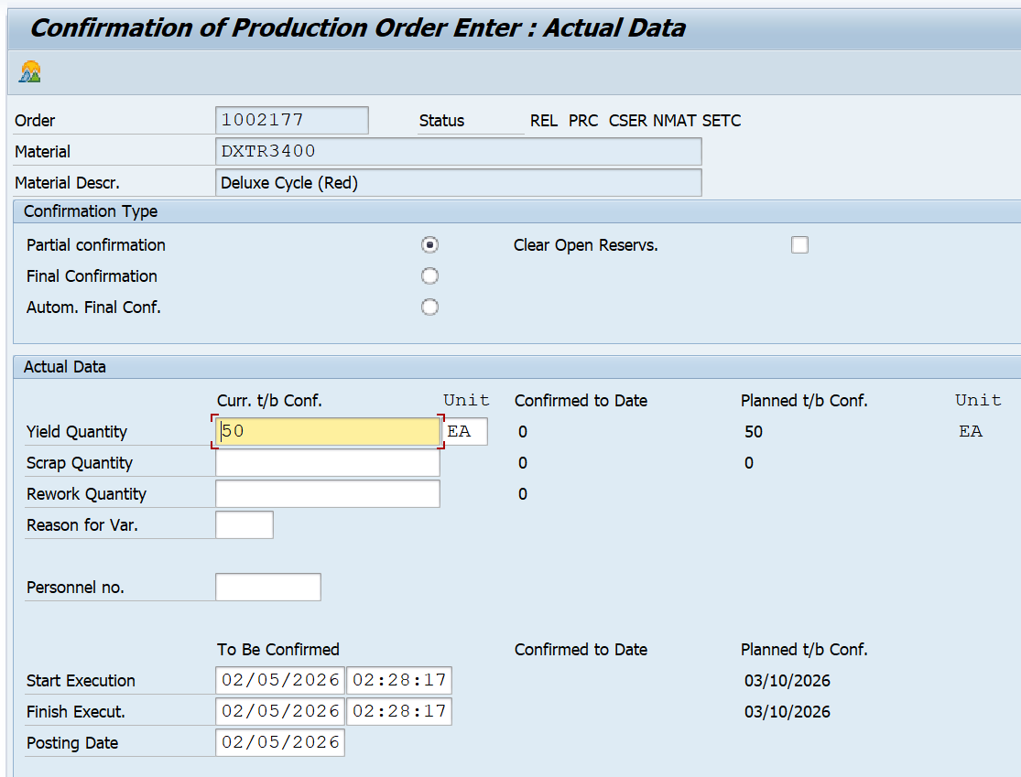
Confirm Production Completion
To confirm Production Order, use T-code: CO15.
We can perform the following activities −
Generate the confirmation document
Consume raw materials or semi-finished goods
Good receipt of the finished goods or semi-finished goods
Click the Goods Movement button at the top of the screen to confirm the automatic goods movement happening along with confirmation.
Auto Goods Receipt (GR), production of material carried out with movement type 101 in the entry.
Auto Goods Issue (GI), consumption of components carried out using movement type 261 in the entry.

Slide 49
It updates the Production Order with actual data:​
Yield quantity (finished goods produced)​
Scrap quantity (defective items)​
Time taken (setup, machine, labor)​
Confirmation is essential for order progress tracking, costing, and capacity planning.
​
For Opening Confirmation Transaction :​
T-code: CO11N (Single Operation Confirmation).​
Purpose: Record confirmation for one production order.​
Confirmation can be:​
Operation confirmation (CO11N) → One operation at a time.​
Order confirmation (CO15) → Entire order at once.​
After Saving System updates:​
Order status → PCNF or CNF.​
Actual quantities and times recorded.​
If automatic GI/GR is active → stock updated.​

Slide 50
Goods Receipt for Production
Goods Receipt (GR) is the process of receiving finished goods intoinventory after production is completed.
It represents the output of the production order.
GR increases stock of the finished product and updates the production orderwith actual receipt.
For Opening Goods Receipt Transaction
T-code: MIGO (modern) or MB31 (classic).
Purpose: Post GR for Production Order.
GR can be posted manually (MIGO/MB31) or automatically during confirmation (CO15).
Click Post, System updates:
Stock increased for finished goods.
Production Order updated with receipt quantity.
Accounting document created.
Mandatory step to make finished goods available in inventory.

Slide 51
REM
Repetitive Manufacturing (REM) is a production method used for continuous, high-volume, repetitive production of the same or very similar products over a long period.
Master Data Required for REM
1️⃣ Material Master
Important settings:
MRP Type: PD
Strategy Group: 10 (MTS)
Production Scheduler
REM Profile (MRP4 view)
2️⃣ BOM (CS01)
Mandatory
Components usually backflushed
No complex alternatives
3️⃣ Routing (CA01)
Rate Routing
Focus on:
Cycle time
Line setup
No detailed operation confirmation like CO11N
4️⃣ Production Version
Links BOM + Routing
Mandatory for REM

Slide 52
End-to-End REM Process Flow
1️⃣ Demand Planning
Create PIR (MD61)
Demand comes from forecast or sales
2️⃣ MRP Run
T-code: MD01 / MD02
Result:
No planned orders
Only planned quantities
3️⃣ REM Planning Table
T-code: MF50
Decide:
How much to produce per day
On which production line
4️⃣ Production Execution
Produce quantity physically
No order release needed
5️⃣ Confirmation & Backflush
T-code: MFBF
System does:
Confirm production quantity
Goods Issue (components)
Goods Receipt (finished goods)

Slide 53
Software Development Life Cycle (SDLC)
1. Requirement Analysis
Gather and understand business requirements for Production Planning.
Identify planning strategies (MTS / MTO), BOM structure, routing needs, work centers, and capacity planning requirements.
Understand integration requirements with MM and SD.
Example: Decide how MRP should plan materials and capacities.
2. Design
Create functional specifications for PP processes.
Design MRP parameters, production versions, scheduling settings, and integration flow with MM and SD.
Example: Define how demand from SD flows into PP and how procurement is triggered.
3. Development
Configure SAP PP in the system using IMG settings.
Create Material Master, BOM, Routing, Work Centers, and Production Versions.
Develop custom reports or enhancements if standard SAP does not meet business needs.
4. Testing
Perform Unit Testing, Integration Testing, and User Acceptance Testing (UAT).
Test MRP runs (MD01), planned orders, production orders, confirmations, and backflush.
Validate integration with MM (component availability) and SD (sales orders).

Slide 54

5. Deployment & Maintenance
Move configurations to production system.
Support end users, monitor production issues, and resolve errors.
Handle change requests for new planning strategies, BOM updates, or capacity adjustments.
Agile Methodology
Implementation is done in small phases (sprints) instead of one long cycle.
Business users provide continuous feedback after each sprint.
Changes are easy to accommodate during the project.
Faster delivery of usable functionality.
Example:
SAP PP is implemented step by step:
Sprint 1 → Material Master & BOM
Sprint 2 → Routing & Work Centers
Sprint 3 → MRP & Production Orders

Slide 55
Thank You

